Slide 1


Lariat: Profit Increase Analysis
Prepared for: Lariat Rent-A-Car
Presented by: Joyce Huan Chan

Slide 2
Background
Lariat is a car rental company in the US with 50 branches and a fleet of 4000 rentable vehicles. The cars are a variety of makes, models, and years, as can be seen in the dataset.
Given the 2018 datasets with information on transactions, various data analyses were performed to find ways to improve business profits.

Slide 3

Lariat in 2018
Total revenue: $52,830,207
Total cost: $33,076,688
Profit: $19,753,518
Profit margin: 37.39%
Average car rental price: $162.31
Total rental days: 325,608
Total cars in fleet: 4000
Notes:
Make sure to ANNUALIZE the revenue for 2018. We’re only given 11 months of data so we can’t say “this was the total revenue for 2018”. We have to estimate what the annual 12 month revenue is based on 11 months of data, even if it’s not a perfect estimate.

Slide 4
Presentation Goals
Review strategies for maximizing revenue and minimizing costs for Lariat in 2019
Compare strategies to baseline to assist in decision making process

Slide 5
2019 Business Goals
Increase profit by at least 20%
Maximize revenue
Reduce costs

Slide 6
Process
Datasets were cleaned, combined and analyzed
4 main strategies were found to maximize revenue and reduce costs

Slide 7

Strategy 1: Increase rental price of Top Profit Cars
Top Profit Cars - cars with a net revenue in the top 5% in 2018 (200 cars out of 4000)
Increase the daily rental price of these cars by 25%
Daily rental price: $169.26 → $211.58
New lowest car price $181.49
New highest car price $235.60
Net revenue: $20,460,358 ( 3.6%)
Notes:
Say the number of cars, not just “top 5%” because it’s hard to do mental math like that. So say top 5% (200 cars)

Slide 8
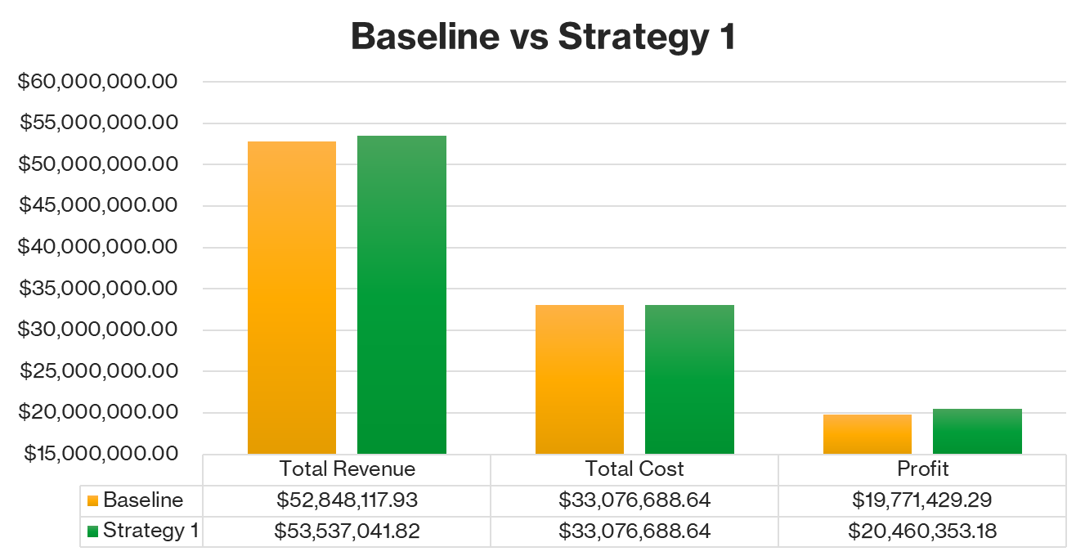

Slide 9
Strategy 2: Remove cars that made a negative profit.
200 vehicles in Lariat’s 2018 fleet (5% of all vehicles) made a negative profit in 2018
Removing these vehicles for the 2019 fleet will reduce costs by $1,848,749 and increase net revenue to $19,964,402

Slide 10
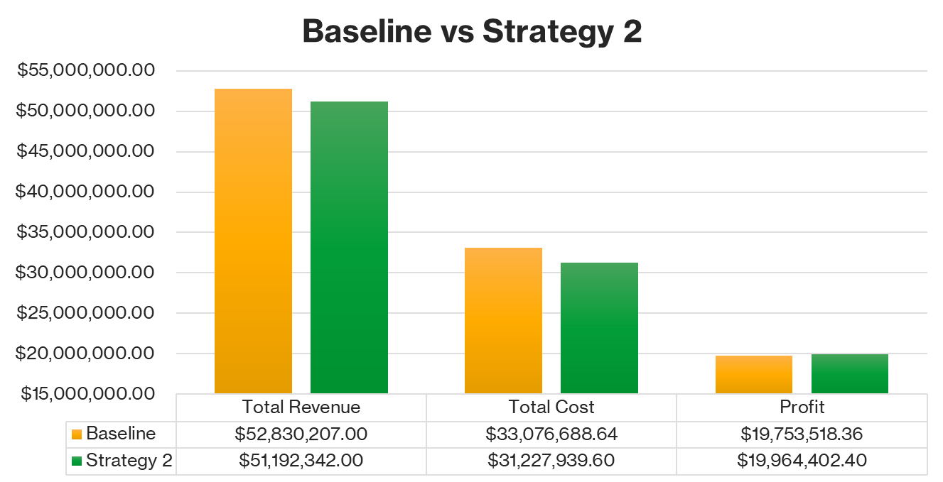

Slide 11
Strategy 3: Add a discount promotion to Mid Profit Cars.
Mid Profit Cars - any car that is not a Top Profit car (3800 out of 4000)
Example promotion: 10% discount on all rentals of Mid Profit Cars
Expect to increase the total rental days by 20% with this discount
Net revenue: $23,674,338 ( 19.8%)

Slide 12
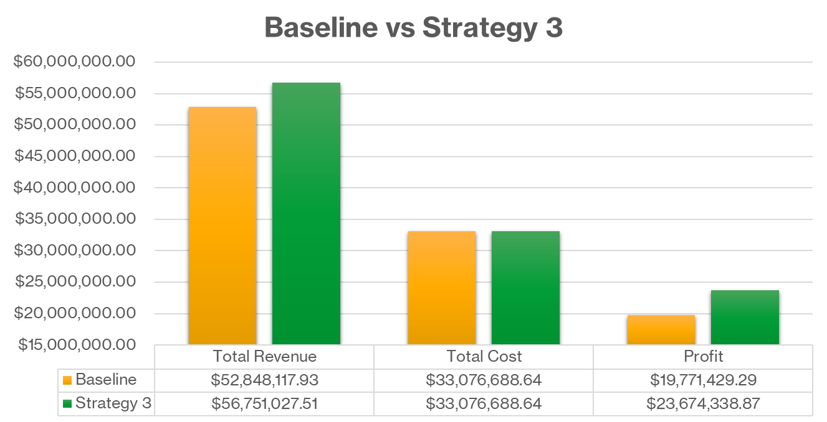
Profit Increase $3,902,909.58

Slide 13
Additional recommendation for discounts
Add an even higher discount in February-March as these were the months with the least revenue in 2018

Slide 14
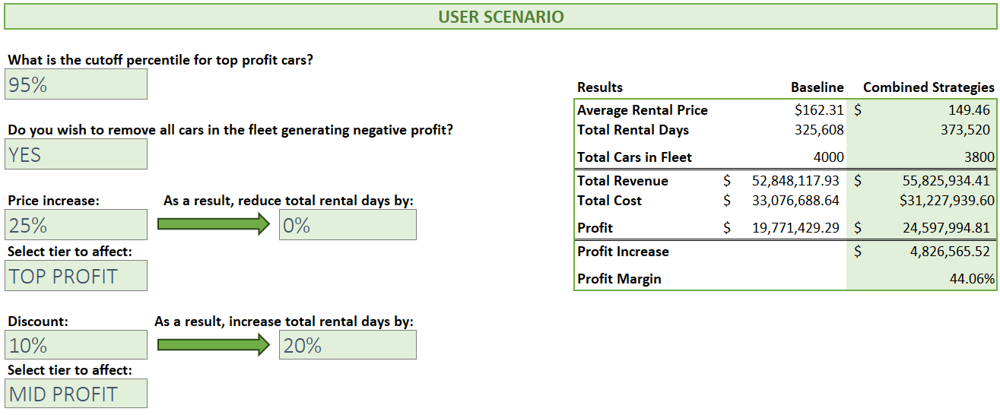
Strategy 4: Combine all above strategies.
Notes:
Take out everything on the left side and insert a table with summary of results from strat 1 to strat 4 (like the one you have in your model.) Left side doesn’t really tell much to the executives, but they’d want to see the data in the table on the right more.

Slide 15

Profit Increase $ 4,826,565.52
Cost Reduction $ 1,848,749

Slide 16
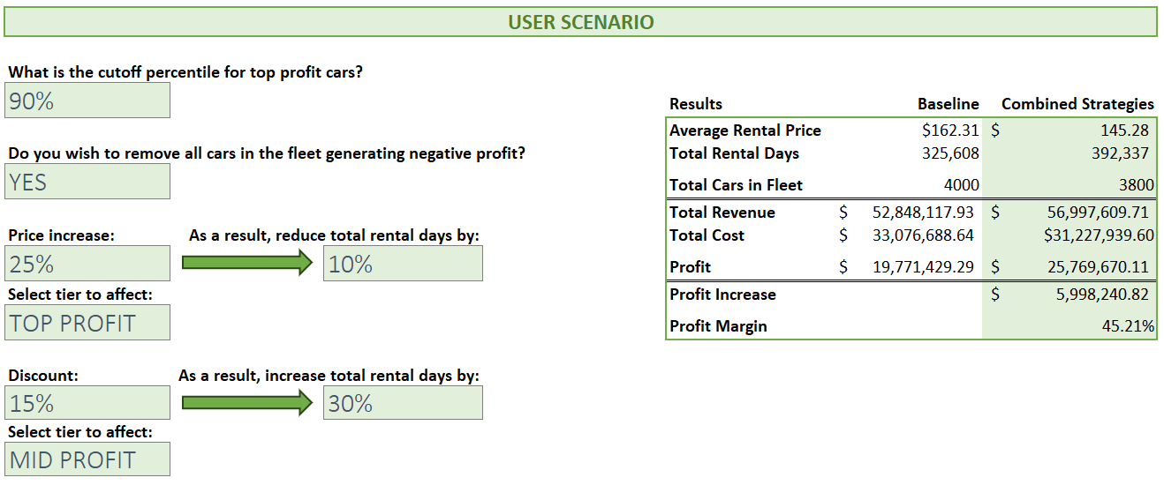
Other possible scenarios
Experiment with different inputs in the User Scenario in the analysis spreadsheet, which will output expected profits in the results table on the right based on your inputs.
Notes:
You’re presenting this slide to managers and executives, but they’re not the ones who will be working with the user scenario interface. That’s gonna be the analysts. So make sure to give a lot of context. Explain what input values you changed and how that affected the results on the right.

Slide 17

Call to action
Lariat 2019’s outlook:
Profit increase: $4.8 million
Cost reduction: $1.8 million
To reach Lariat’s business goals for 2019, implement strategy 4 (combination of strategies 1, 2, and 3)
Increase rental price of top-profiting cars by 25%
Remove all cars that made a negative profit
Apply 10% discount promotion to all other cars and expect a 20% increase in rentals
Optimize company plan for 2019 by using the User Scenario interface in the analysis spreadsheet, as well as potential A/B testing
Further recommendations and information can be found in the analysis spreadsheet, such as recommendations for individual branches and vehicles
Notes:
Make sure to refer back to the business goals you laid out in the beginning and say that you met them. Ie. We met our goal for profit increase of 20%
Put percentage for profit increase and cost reduction.

Slide 18
Questions?

Slide 19

Thank you!
Please contact Huan Png for any questions or future analytics needs.

